Slide 1
Product 2D Dimensions

Slide 2
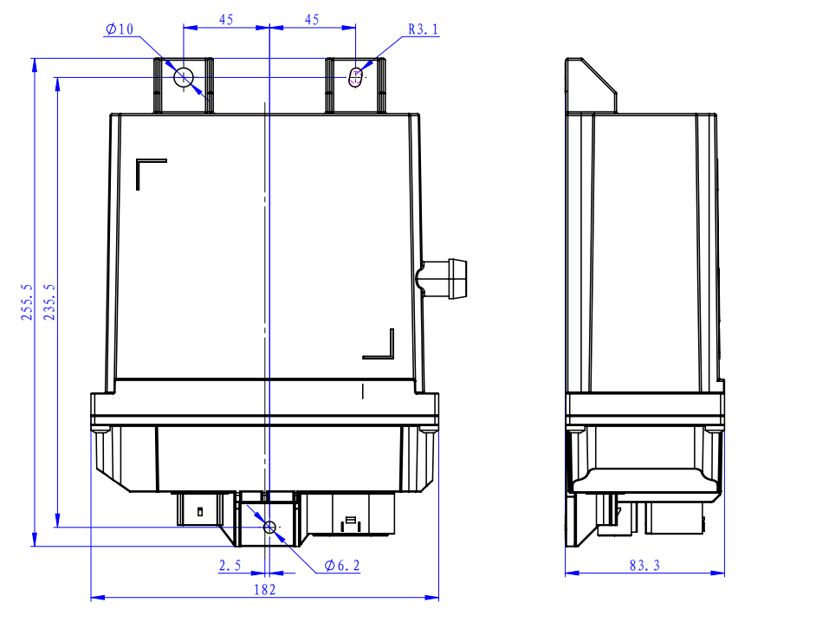
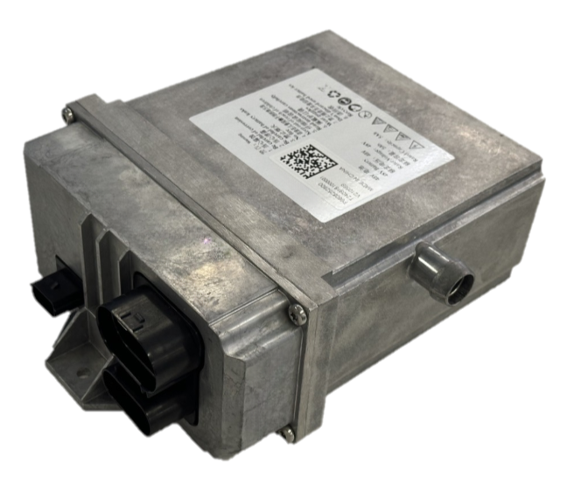
1 48V 5Ah Backup Battery ASIL B

