Slide 1
Product 2D Dimensions

Slide 2
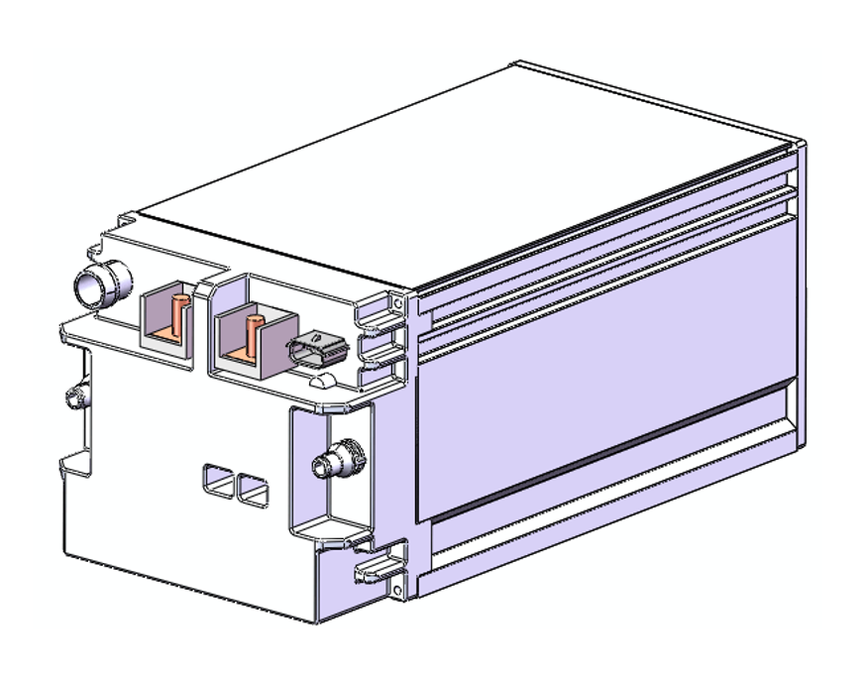
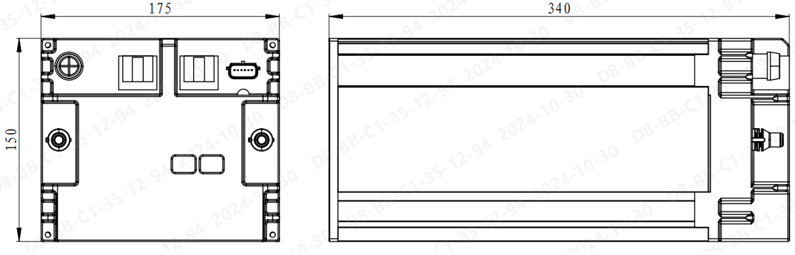
48V 23Ah MHEV battery

