Slide 1
Product 2D Dimensions

Slide 2
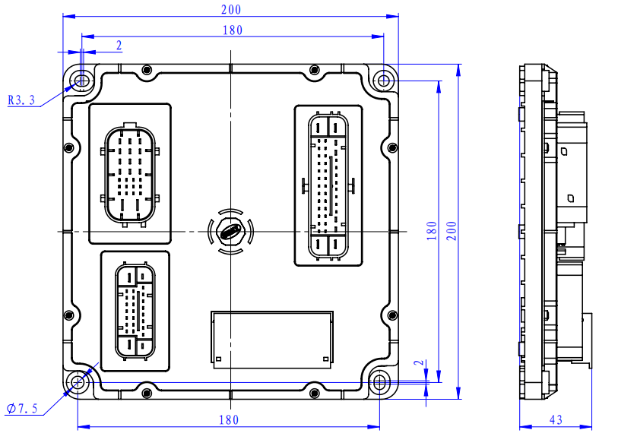
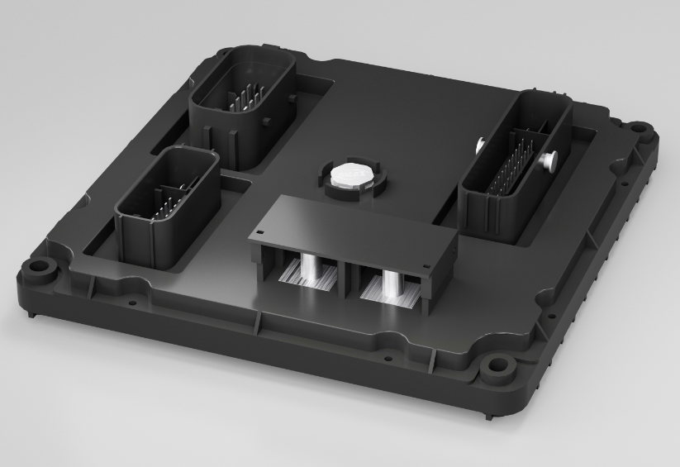
二维尺寸-FPDU

