Slide 1
Product 2D Dimensions

Slide 2
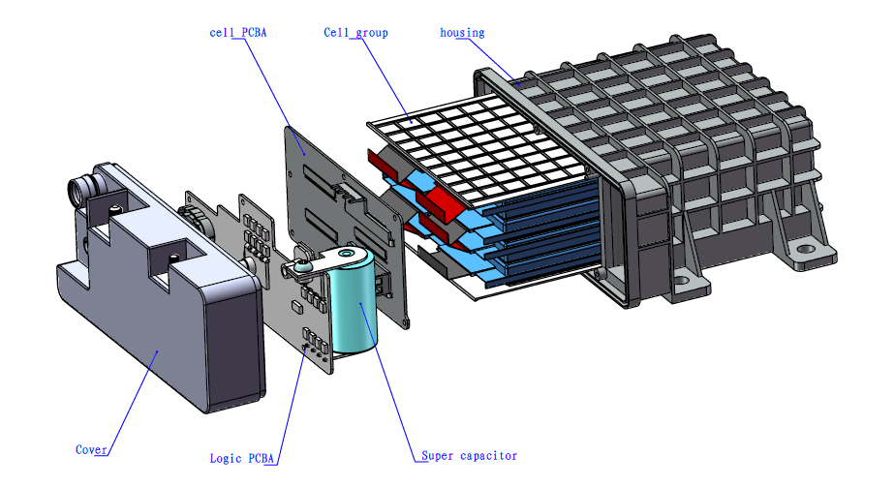
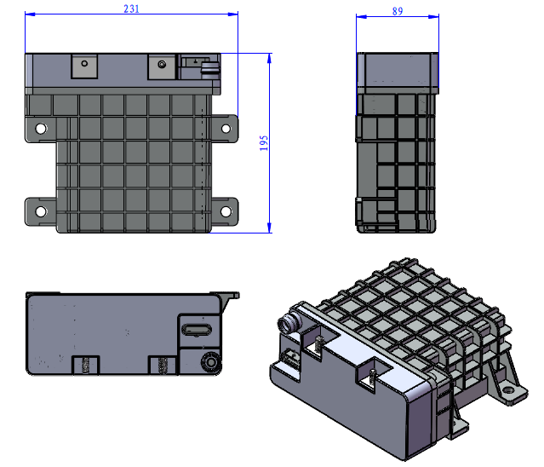
Li-ion Battery Series Supercapacitor

